Slide 1
Deep Learning for Medical Researchers
Sam Green and
Prof. Çetin Kaya Koç

Slide 2
Last time
Introduced regression and classification

Slide 3
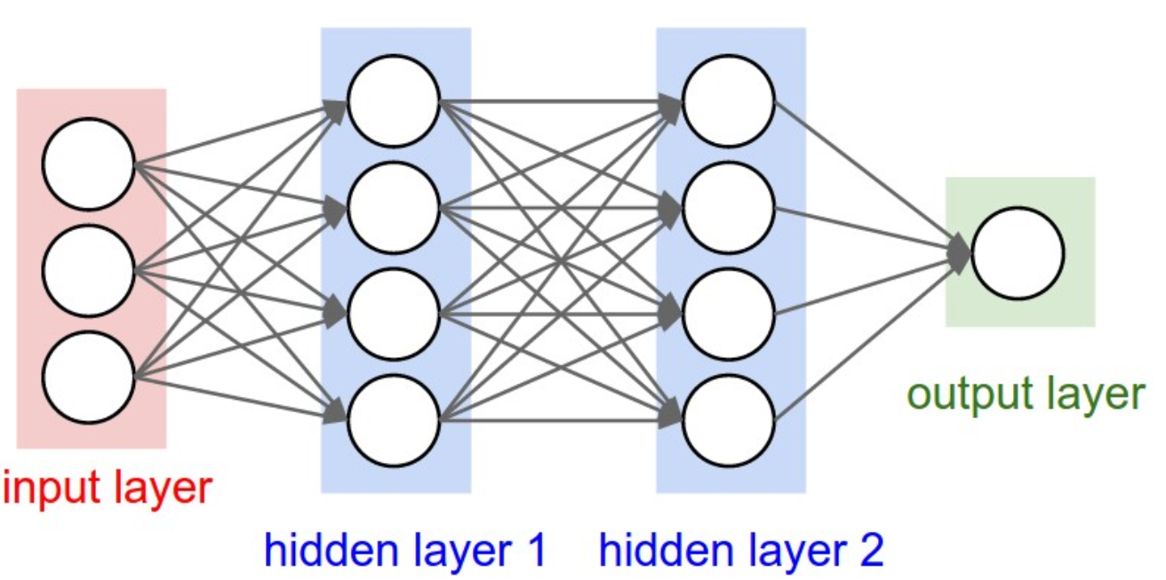
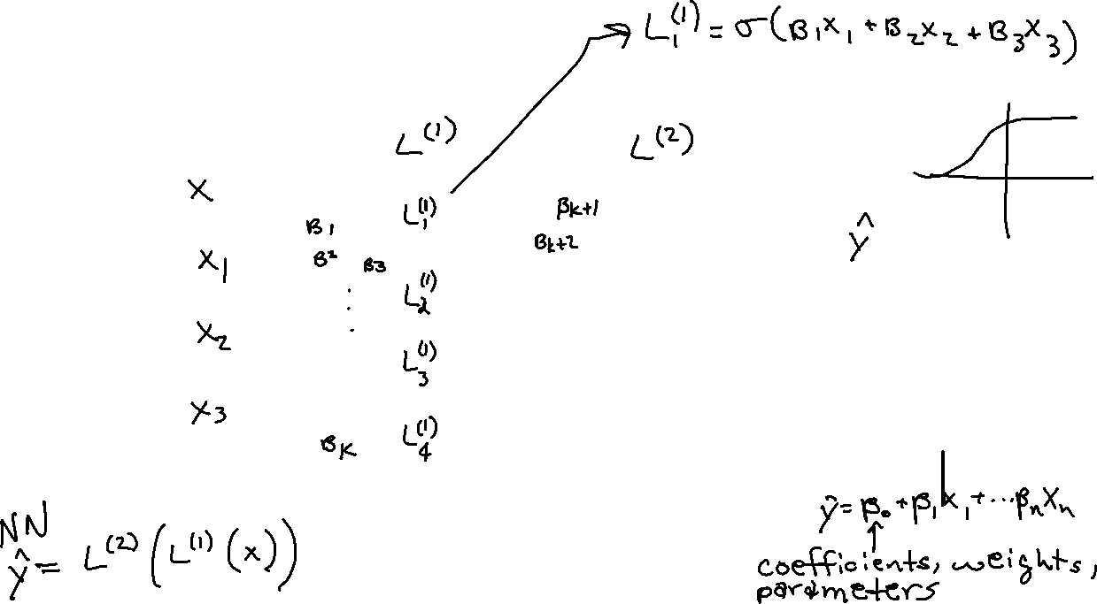
Multi-Layer Perceptron Technically a deep neural network (DNN)
http://cs231n.github.io/neural-networks-1/

Slide 4
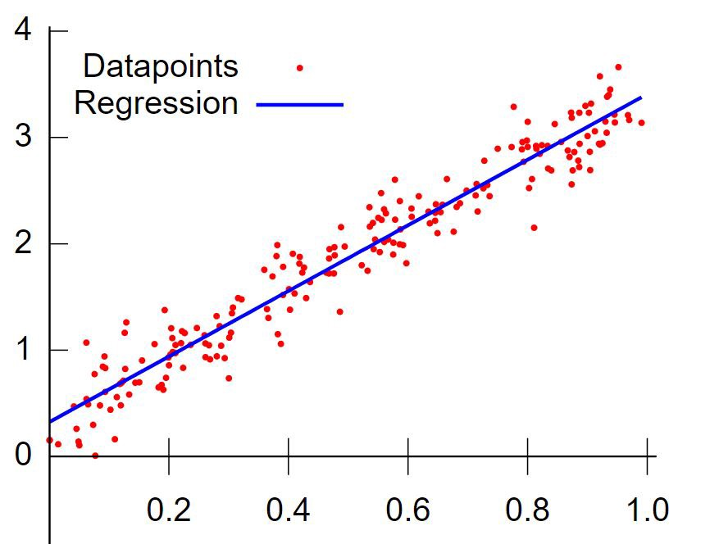
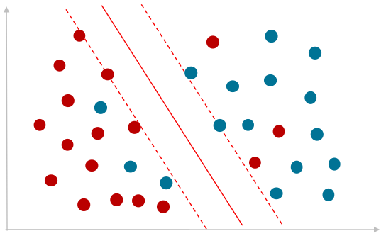
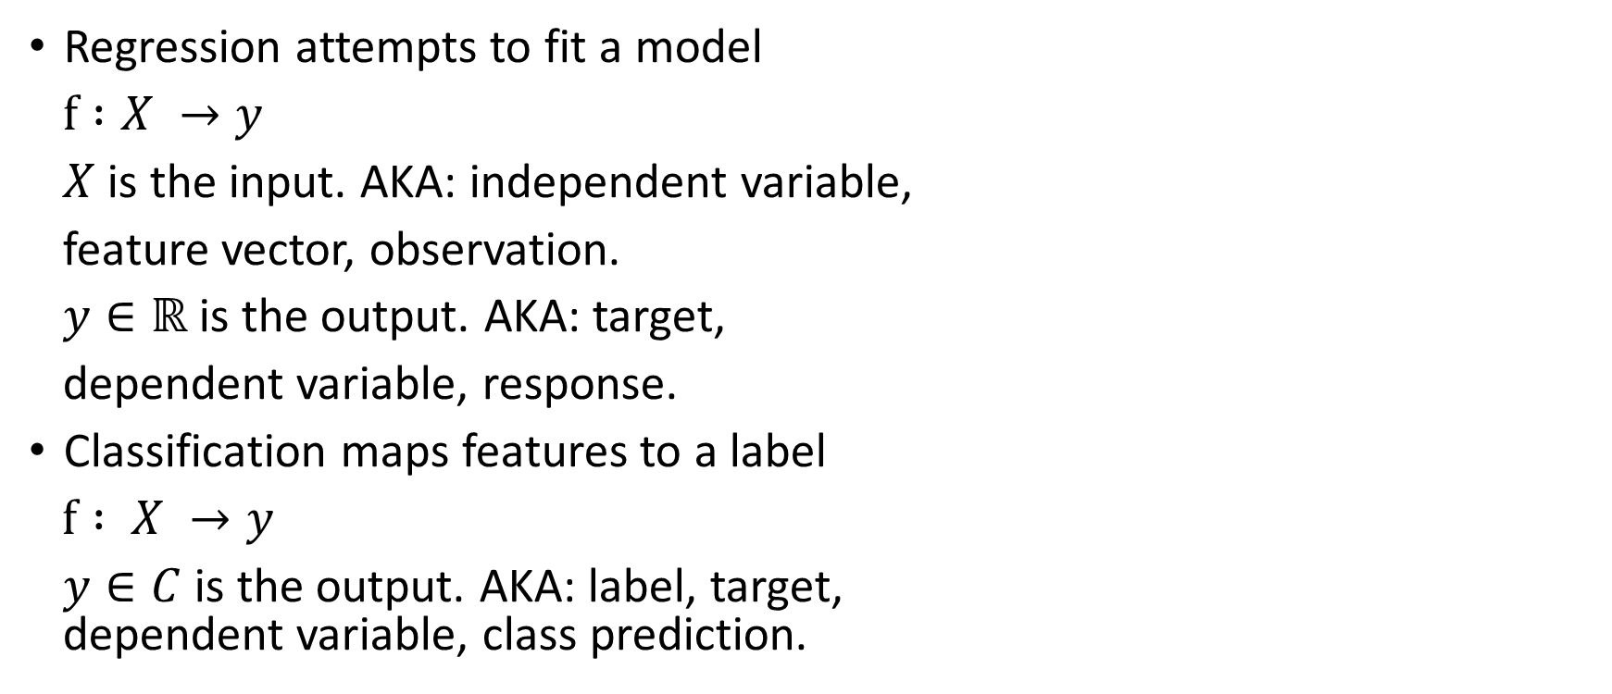
Regression and Classification
Regression attempts to fit a model
$f :X →y$
$X$ is the input. AKA: independent variable,
feature vector, observation.
$y∈ℝ$ is the output. AKA: target,
dependent variable, response.
Classification maps features to a label
$f : X →y$
$y∈C$ is the output. AKA: label, target, dependent variable, class prediction.
Image credit: https://blogs.oracle.com
Image credit: https://medium.com/deep-math-machine-learning-ai

Slide 5
Today
Python coding
Model generalization
Error metrics
Cross-validation
Regularization

Slide 6
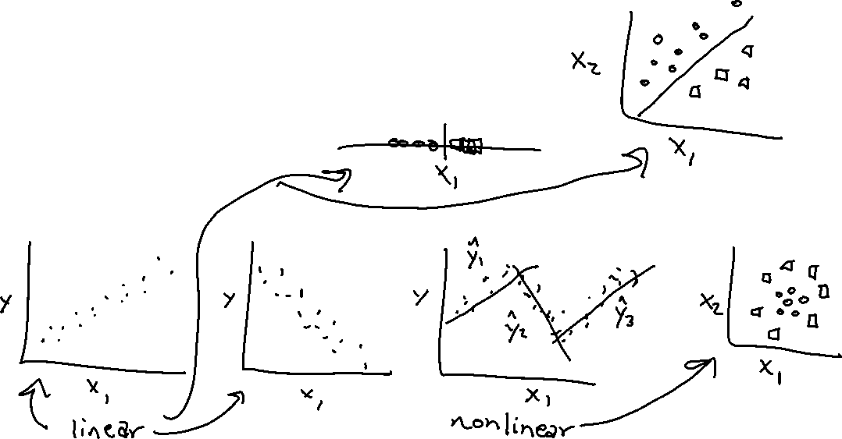
Mathematical models
Equations that attempt to explain observed data
Two general types
Linear
Non-linear

Slide 7
Model generalization
How well does model work with new data

Slide 8
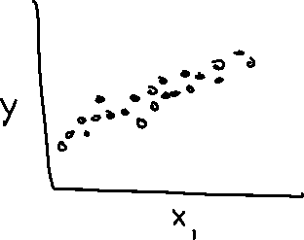
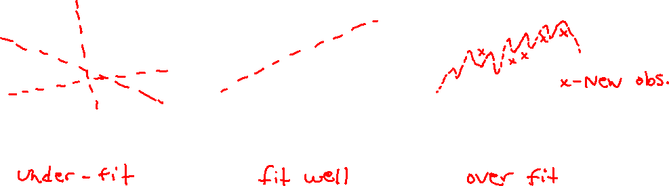
Underfitting and overfitting (regression)

Slide 9
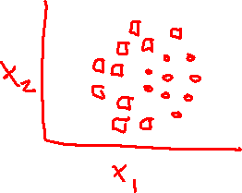
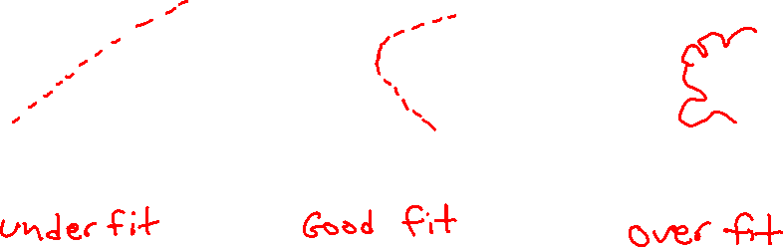
Underfitting and overfitting (classification)

Slide 10
Error metrics
How to evaluate the performance of your model

Slide 11
Evaluating model performance
Measuring the “distance” between model output and desired output
L2-norm
L1-norm
Loss function (AKA cost function, objective function, criterion)
Mean Squared Error (used for regression
Mean Absolute Error (used for regression)
Cross entropy (used for classification)

Slide 12
Norm
From linear algebra
Norm – function that assigns a positive “length” to a vector
Most familiar is the Euclidean norm

Slide 13

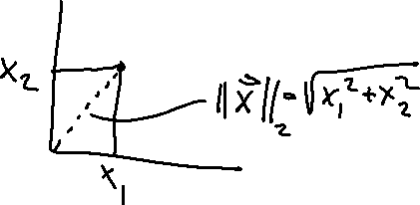
L2-norm (regression)
${\left\|x\right\|}_{2}=\sqrt{x_{1}2+x_{2}2+…+x_{n}2}$
Euclidean norm in $ℝn$

Slide 14

Mean Squared Error (MAE)
Related to L2-norm
The average difference between predictions and labels
MAE = $\frac{1}{N}\sum_{i=1}^{N}{{\left({\hat{y}}_{i}−y_{i}\right)}^{2}}$

Slide 15

L1-norm (regression)
${\left\|x\right\|}_{1}= \left|x_{1}\right|+\left|x_{2}\right|+…+\left|x_{n}\right|$

Slide 16

Mean Absolute Error
MAE = $\frac{1}{N}\sum_{i=1}^{N}{\left|{\hat{y}}_{i}−y_{i}\right|}$

Slide 17

Cross entropy
Measures the distance between distributions
$H\left(y,\hat{y}\right)= −\sum_{i=0}^{n}{y_{i}log\left({\hat{y}}_{i}\right)}$

Slide 18
Cross-validation
Principled method to train model and test its generalization ability

Slide 19
Cross-validation (train-test split)
If your model is trained on all of your data, then you have no idea how well it will work in the real world
Rule of thumb for standard ML is to use
80% of available data for training
20% for testing
(Deep learning has different rule of thumb)

Slide 20
Recent results

Slide 21
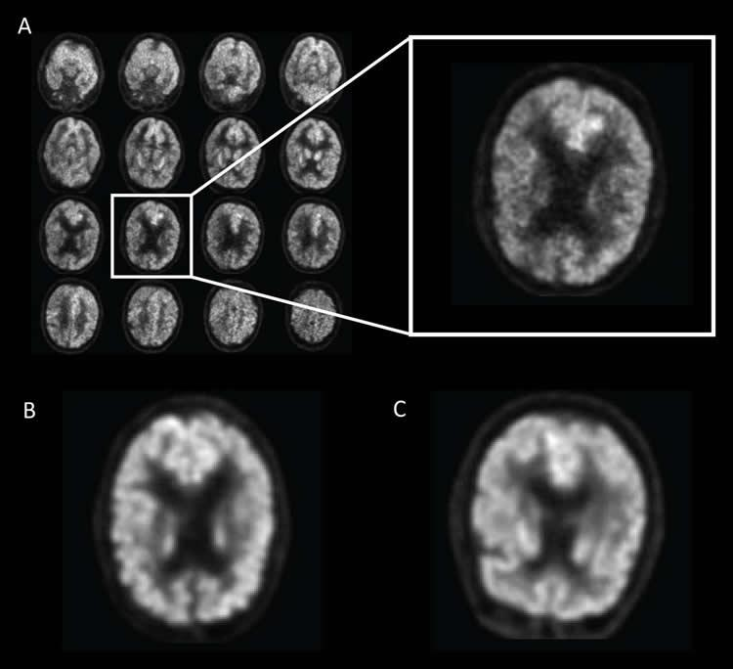
A Deep Learning Model to Predict a Diagnosis of Alzheimer Disease by Using F-FDG PET of the Brain
Training set: 1800 PET images
Test set: 200 PET images
ROC curve of 0.98
82% specificity at 100% sensitivity
https://pubs.rsna.org/doi/10.1148/radiol.2018180958

Slide 22
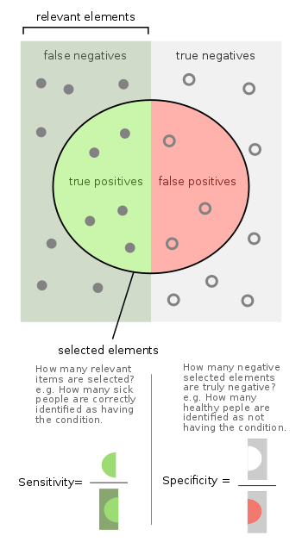

Slide 23
